Slide 1
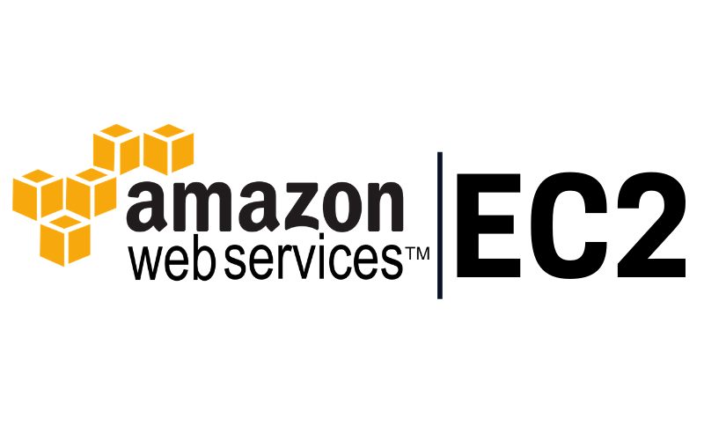

Slide 2
To do
EC2 – Linux
Security Group
EBS – Volume & Snapshot
AMI

Slide 3
Point to remember (EC2):
Termination Protection is turned off by default, you must turn it on
On an EBS-backed instance, the default action is for the root EBS volume to be deleted when the instance is terminated.
EBS Root Volumes of your DEFAULT AMI's CAN be encrypted. You can also use a third-party tool (such as bit locker etc) to encrypt the root volume or this can be done when creating AMI's (lab to follow) in the AWS console or using the API

Slide 4
Point to remember(Security Group):
All inbound traffic is blocked by default
All outbound traffic is allowed
Security Group are STATEFULL
If you create an inbound rule allowing traffic in, that traffic is automatically allowed back out again
Changes to Security group take place immediately
You can have any number of EC2 instances within a Security Group
You can have multiple security groups attached to EC2 instances.
You cannot block specific IP addresses using Security Groups, instead use Network Access Control Lists
You can specify allow rules, but not deny rules

Slide 5
Point to remember(Volume and snapshots):
Volumes exist on EBS. Think of EBS as Virtual hard disk
Snapshots exits on S3. Think of snapshots as a photograph of disk.
Snapshots are point in time copies of volume.
Snapshots are incremental - this means that only the blocks that have changed since your last snapshot are moved to s3
If this is your first snapshot, it may take some time to create

Slide 6
Point to remember(Volume and snapshots):
To create a snapshot for Amazon EBS volumes that serve as root devices, you should stop the instance before taking the snapshot
However, you can take a snap while the instance is running
You can create AMI's from Snapshots
You can change EBS volume sizes on the fly, including changing the size and storage type.
Volumes will ALWAYS be in the same availability zone as the EC2

Slide 7
Point to remember(Volume and snapshots):
To move an Ec2 Volume from one AZ to another, take a snapshot of it, create AMI from the snapshot and then use the AMI to launch the Ec2 instance in a new AZ
To move an EC2 volume from one region to another, take a snapshot of it, create an AMI from the snapshot and then copy the AMI from one region to the other. Then use the copied AMI to launch the new Ec2 instance in the new region

Slide 8
Point to remember(CLI):
You can interact with AWS from anywhere in the world, just using the command line(CLI)
You will need to set up access in IAM
Commands themselves are not in the exam, but some basic commands will be useful to know for real life

Slide 9
Identity access Management Roles :
Roles are more secure than storing your access key and secret access key on individual EC2 instances.
Roles are easier to manage.
Roles can be assigned to an EC2 instance after it is created using both the console & command line
Roles are universal - you can use them in any region

Slide 10
EC2 Instance Meta Data :
Used to get information about an instance(such as public ip)
curl http://169.254.169.254/latest/meta-data/
curl http://169.254.169.254/latest/user-data/
curl http://169.254.169.254/latest/meta-data/ami-id
curl http://169.254.169.254/latest/meta-data/local-ipv4
curl http://169.254.169.254/latest/meta-data/public-ipv4

Slide 11
Thank you

